Slide 1

Semantically Informed Slang Interpretation
Zhewei Sun, Richard Zemel, and Yang Xu
Department of Computer Science
University of Toronto

Slide 2
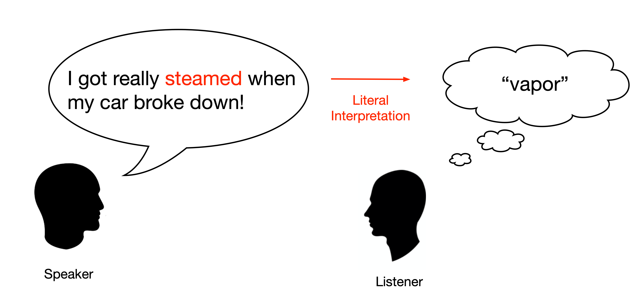

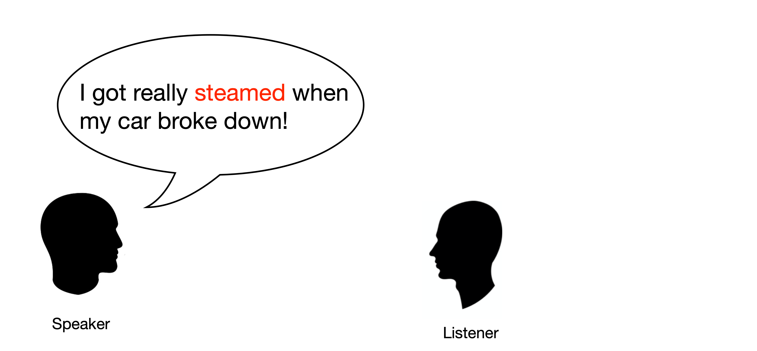
Slang interpretation
Slang is a type of informal language that can frequently occur in natural conversations.

Slide 3
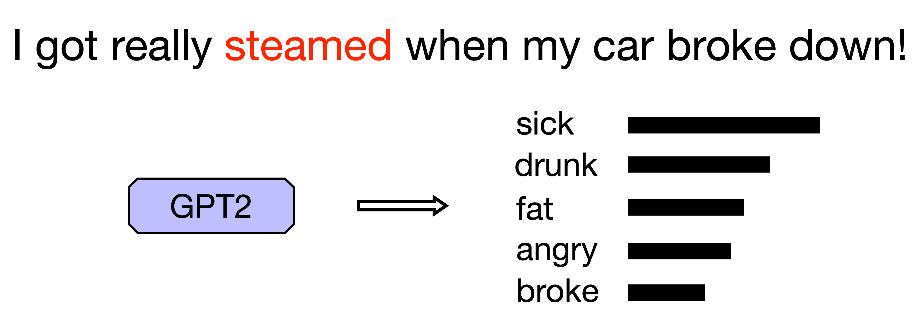
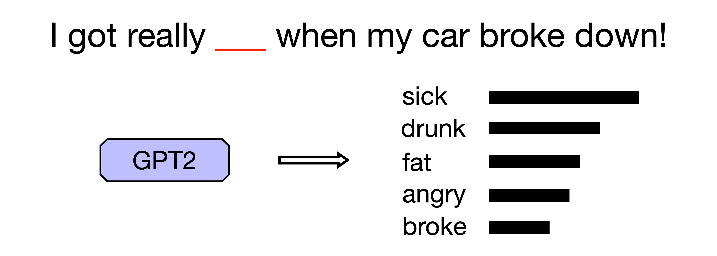
Context-based Interpretation
Previous approaches infer slang meaning from the usage context.
E.g. I got really ___ when my car broke down!
Seq2seq-based translation models for slang interpretation (Ni and Wang, 2017)
However, the context is generally underspecified:

Slide 4
What about the slang word?
Encode the slang word’s morphological form (Ni and Wang, 2017).
Incorporate a model of slang semantic extension:
Given the conventional meaning of a word, how likely will it be used to express a meaning?
Can be used to infer the appropriateness of a meaning with respect to a word.
Consider both context and semantics when interpreting slang.

Slide 5
Problem formulation
Input:
A slang expression within a sentence.
Usage context of the slang.
Output: A definition for the slang expression in the given usage context.
Steamed
I got really steamed when my car broke down!
Being angry.

Slide 6
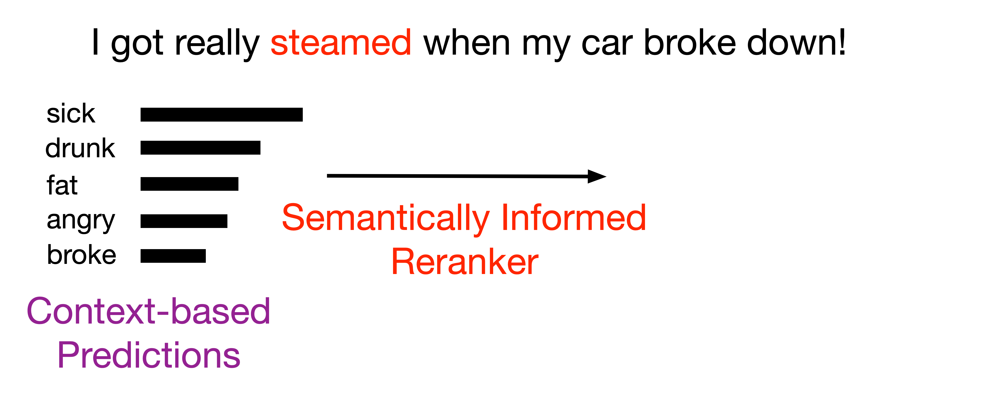
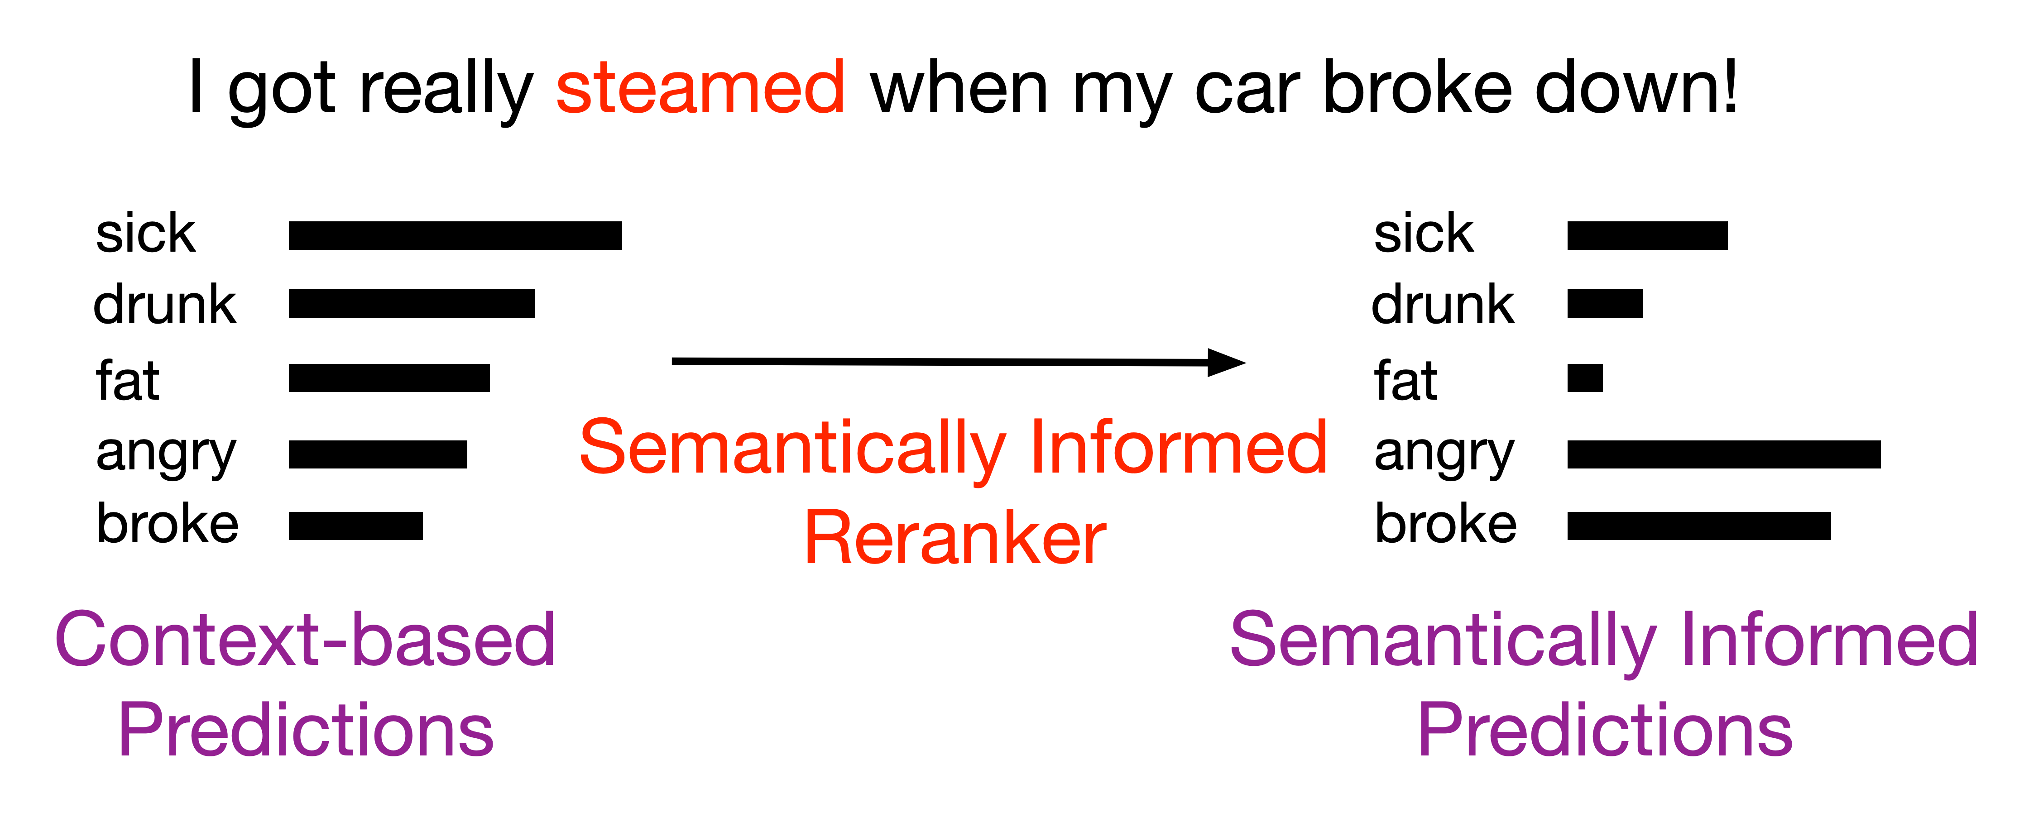
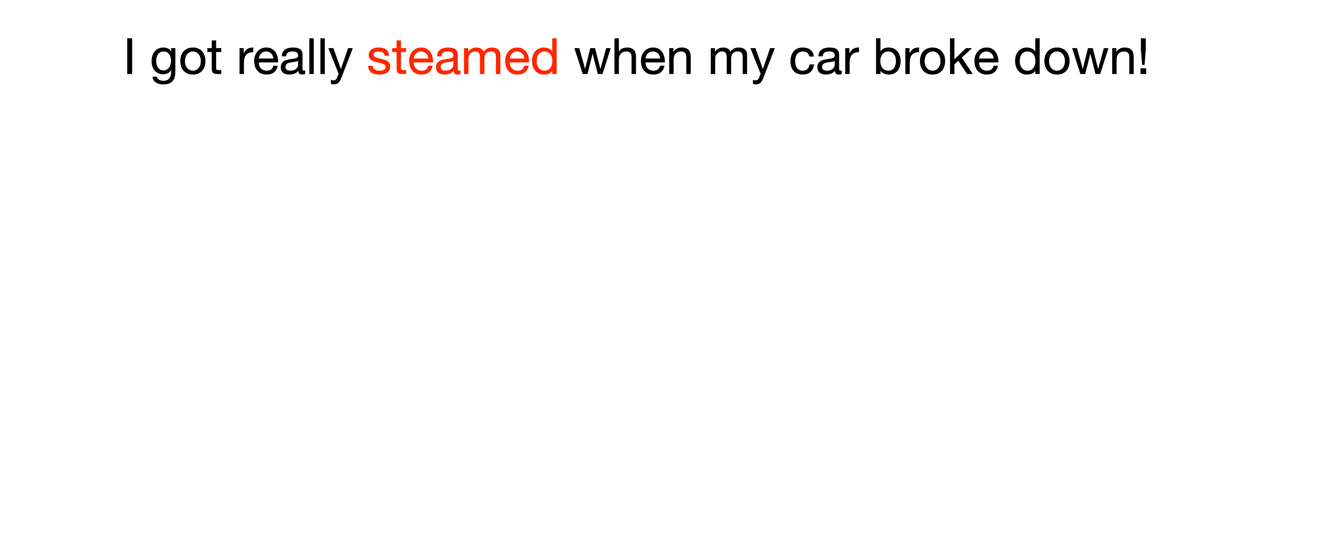
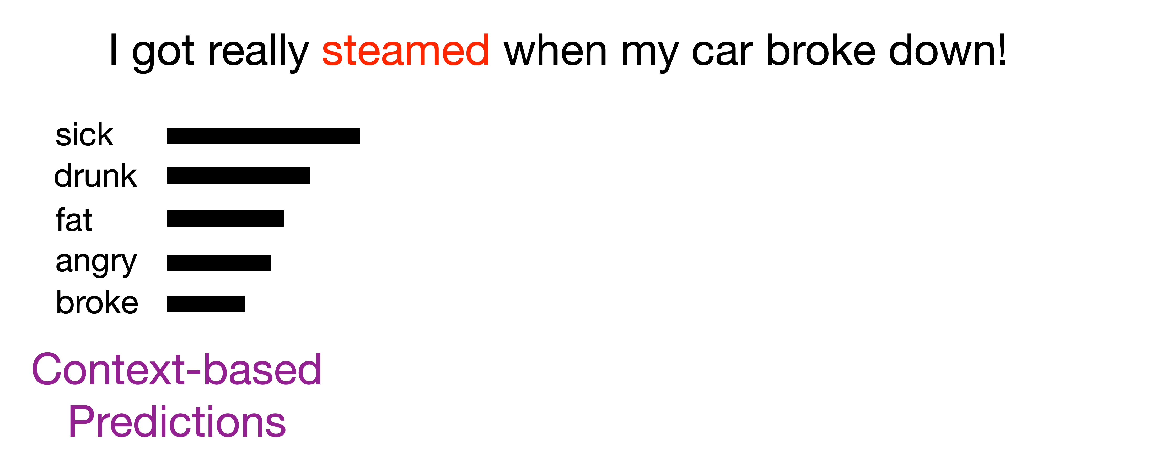
Model – Overview

Slide 7
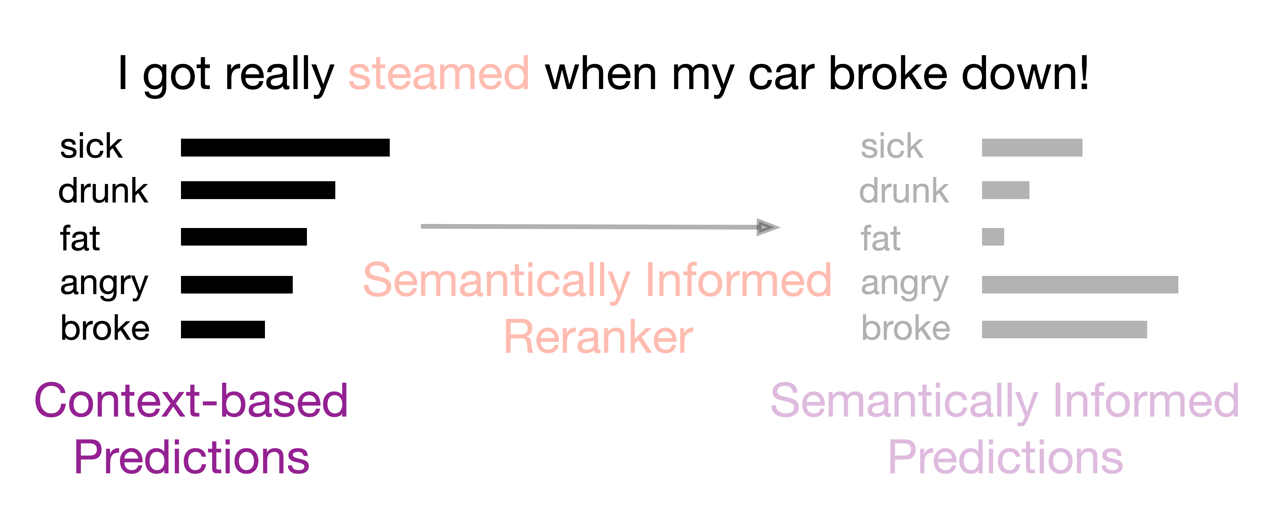
Model – Baseline
Step 1 - Obtain a list of candidate interpretations using the context.
GPT-2 based language infilling (Donahue et al., 2020).
Given the context, retrieve the list of most likely words for the blank.
Prefer words that share the same POS tag as the slang.

Slide 8
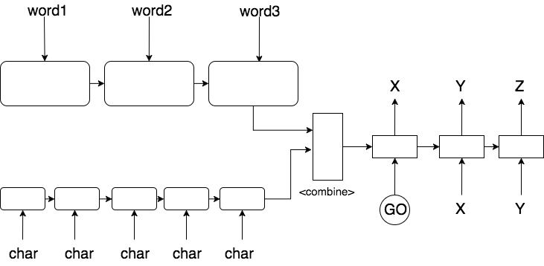
Model – Baseline
Seq2Seq based dual decoder (Ni and Wang, 2017):

Slide 9
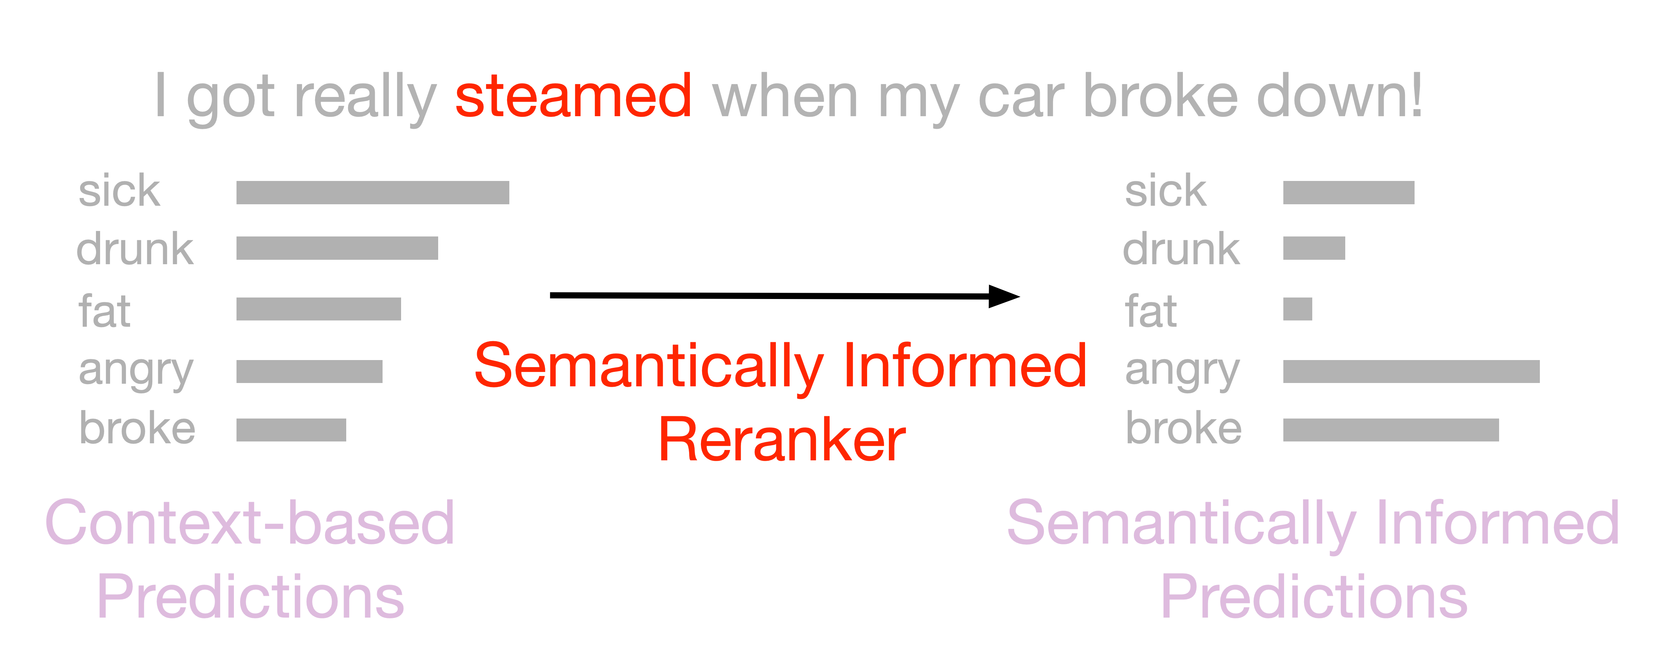
Model – Slang semantics
Step 2 - Check the appropriateness of each candidate meaning against conventional senses of the slang word.
Apply a model of slang semantic extension (Sun et al., 2021) where both conventional and slang senses are represented using contrastively learned sense embeddings

Slide 10
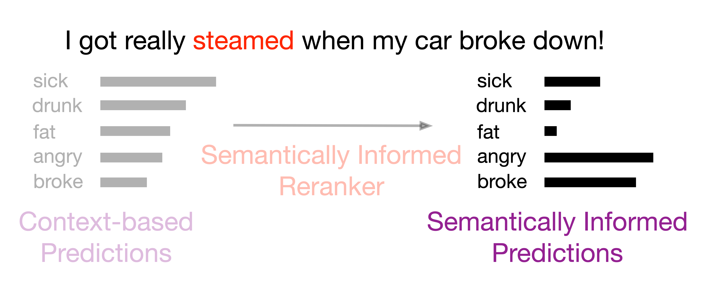
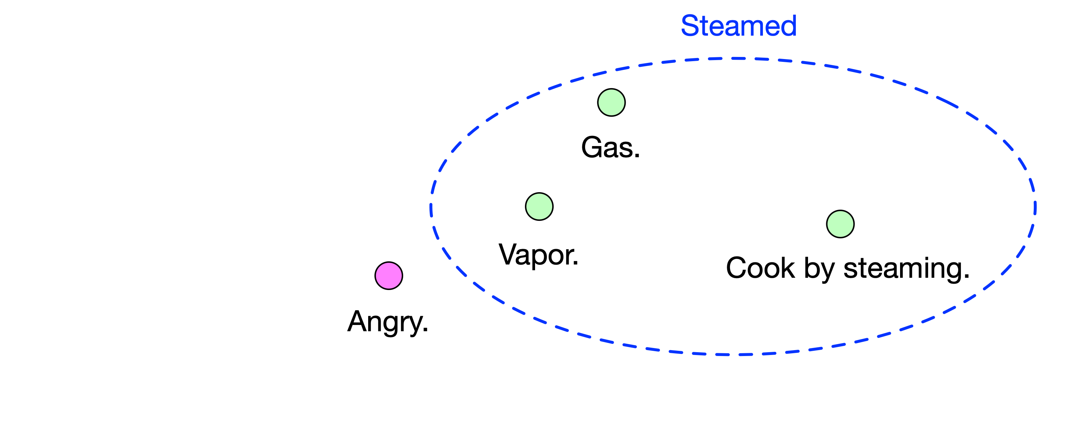
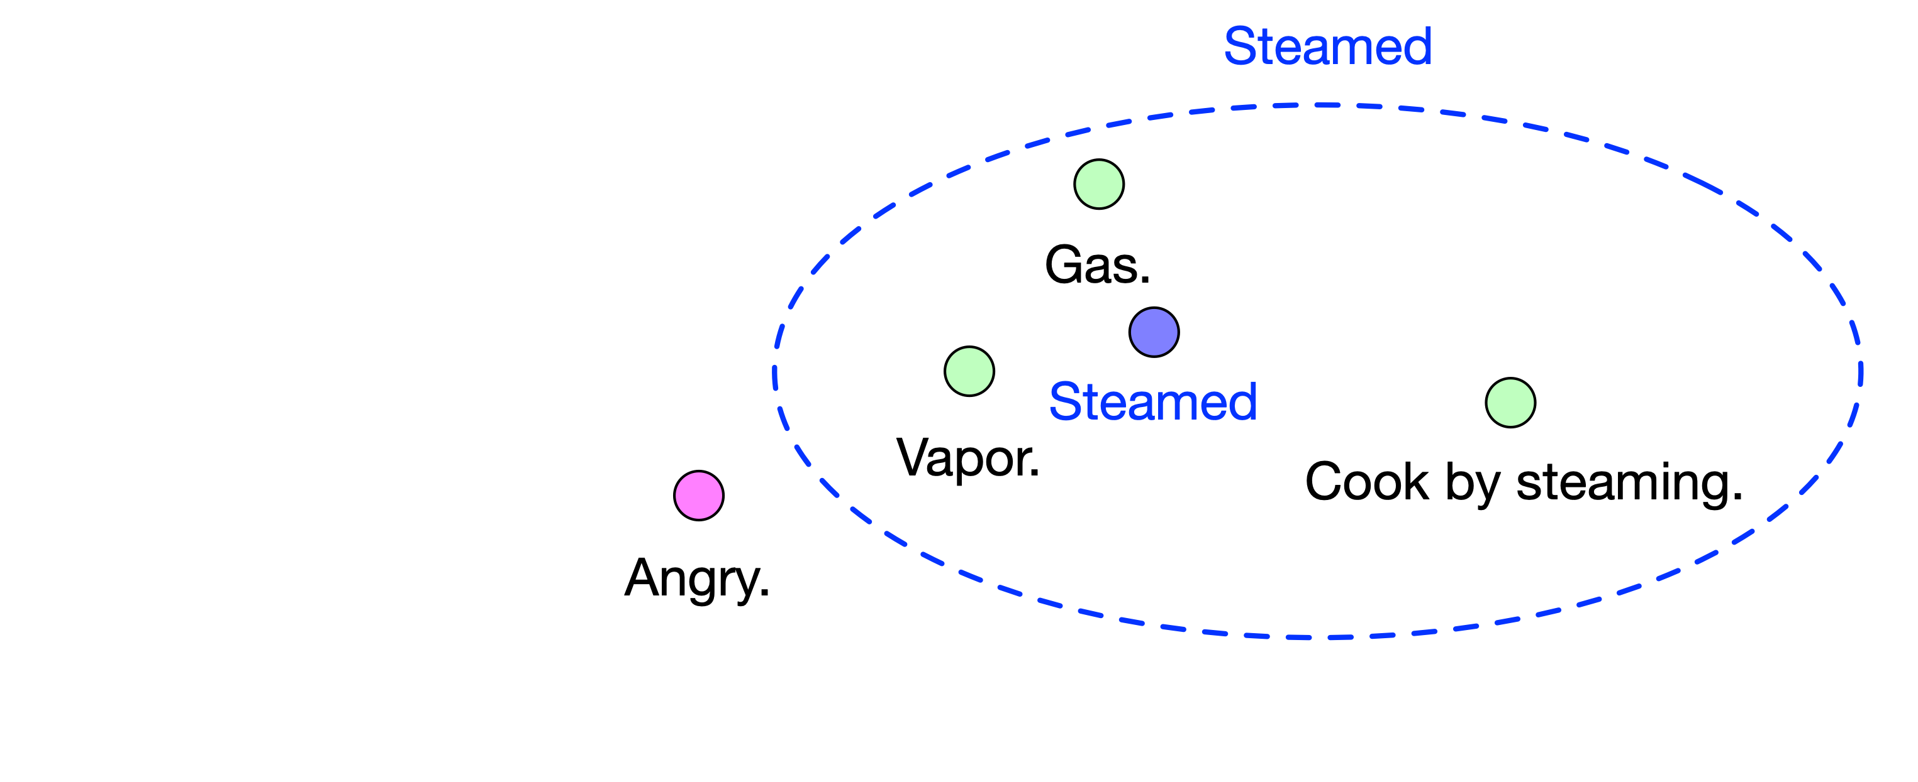
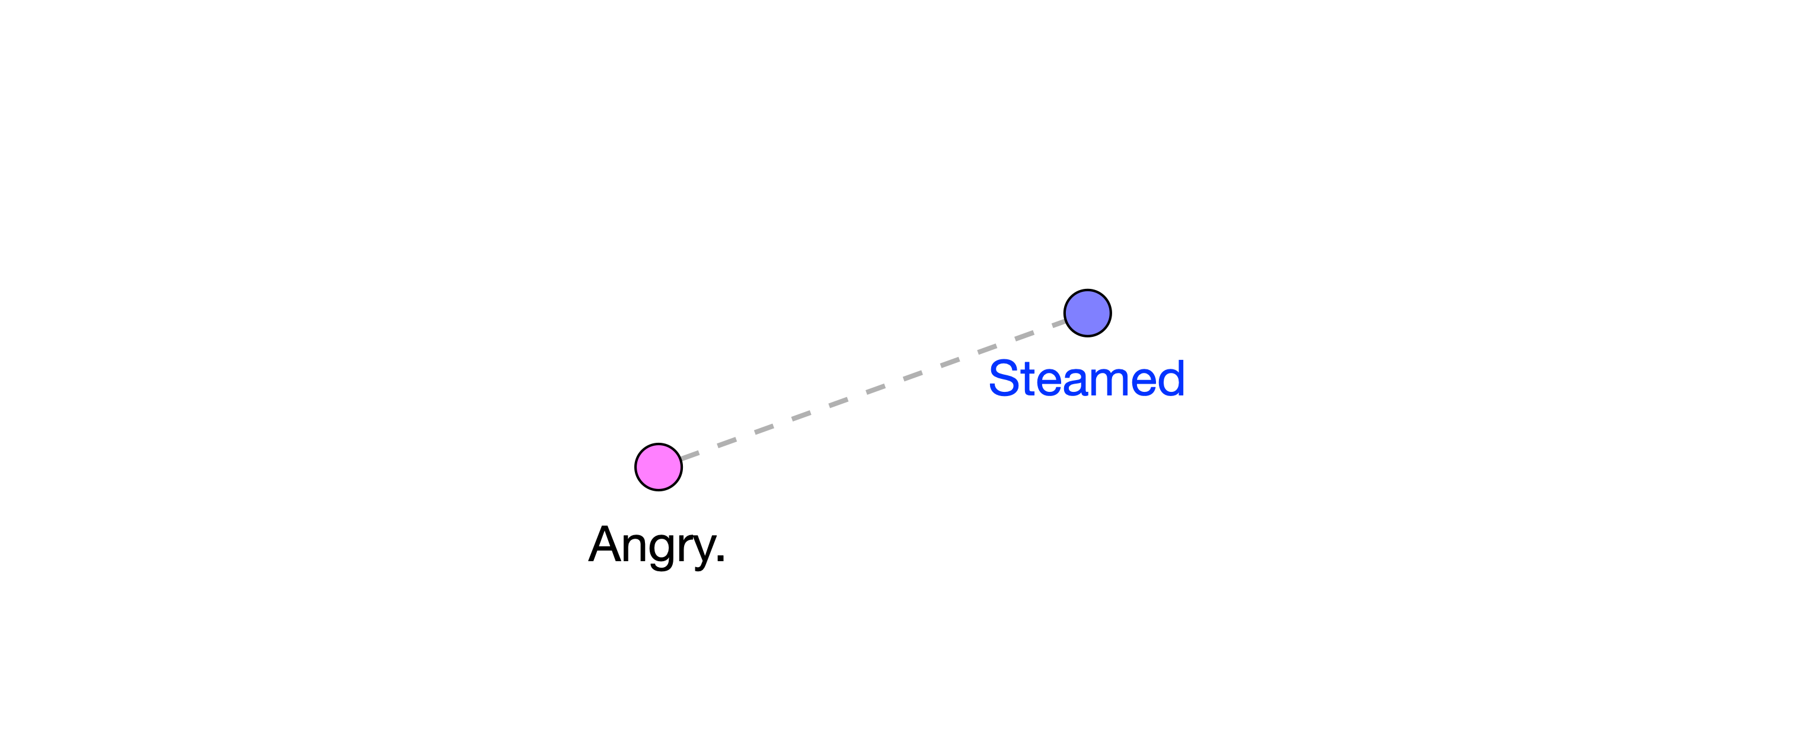
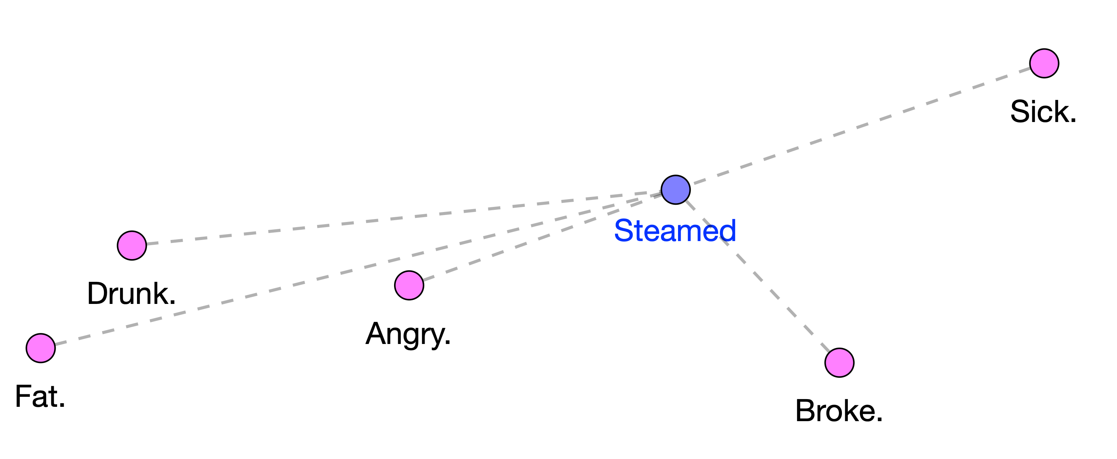
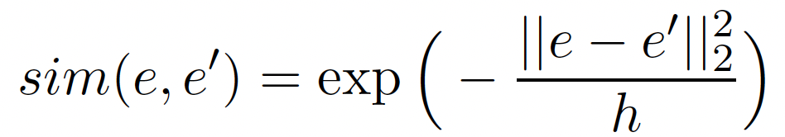
Model – Slang semantics

Slide 11
Datasets
Each example usage sentence from a slang dictionary entry is used as an example (10% held out for testing):
Online Slang Dictionary (OSD)
3,718 sentences from 2,979 slang definition entries.
Urban Dictionary (UD)
Dataset from Ni and Wang (2017).
65,487 sentences where each corresponds to a slang definition entry.
Conventional definitions obtained from Online English Dictionary by Oxford (OD).

Slide 12
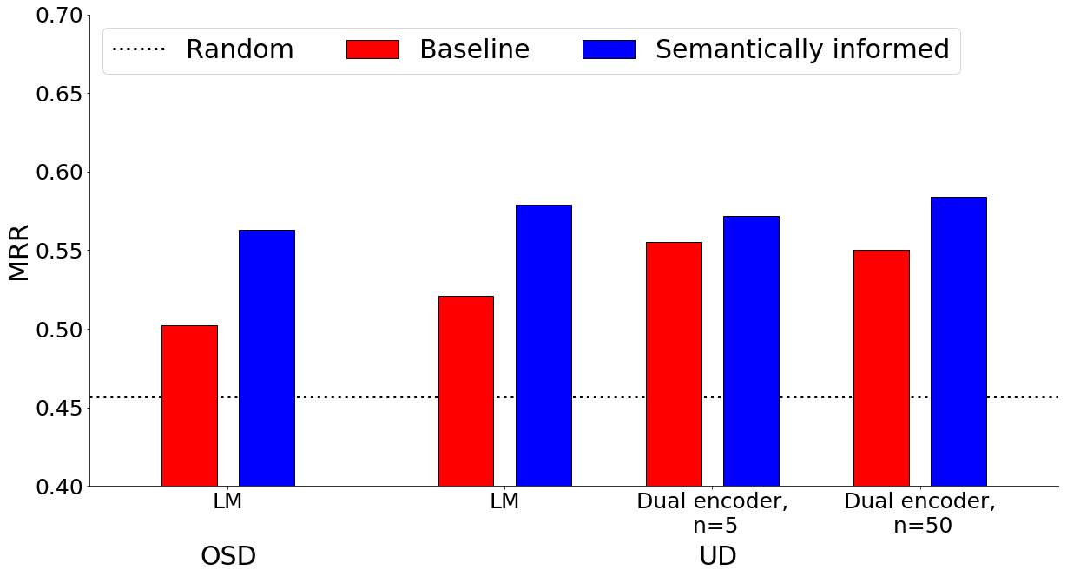
Results – Slang interpretation
Evaluation: Rank the predicted definition against the groundtruth and 4 randomly sampled definitions using Sentence-BERT (SBERT). Report the mean-reciprocal rank (MRR) of the groundtruth definition.

Slide 13
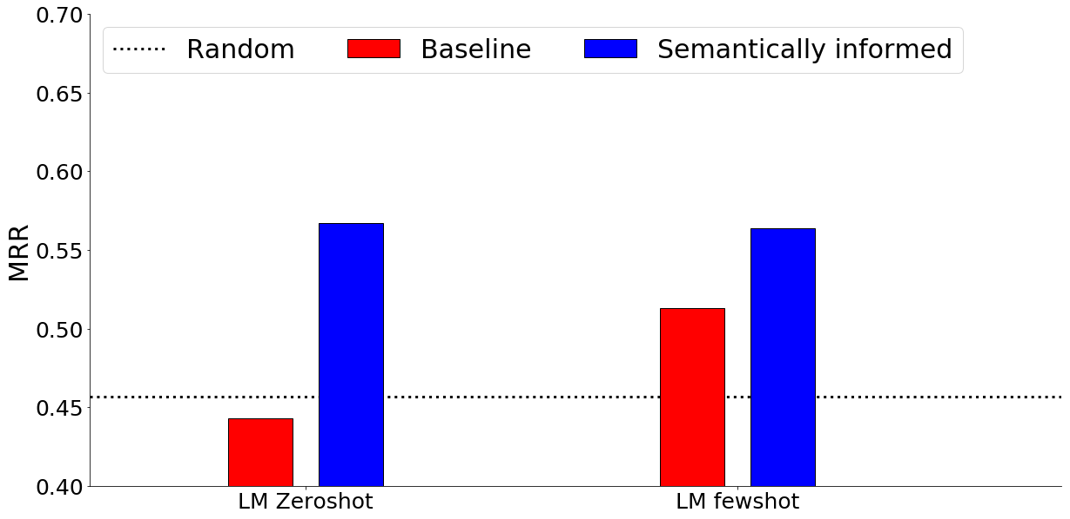
Results – Slang interpretation
On OSD definition entries with more than one usage sentence, finetune the LM on one of the sentences and test on the rest:

Slide 14
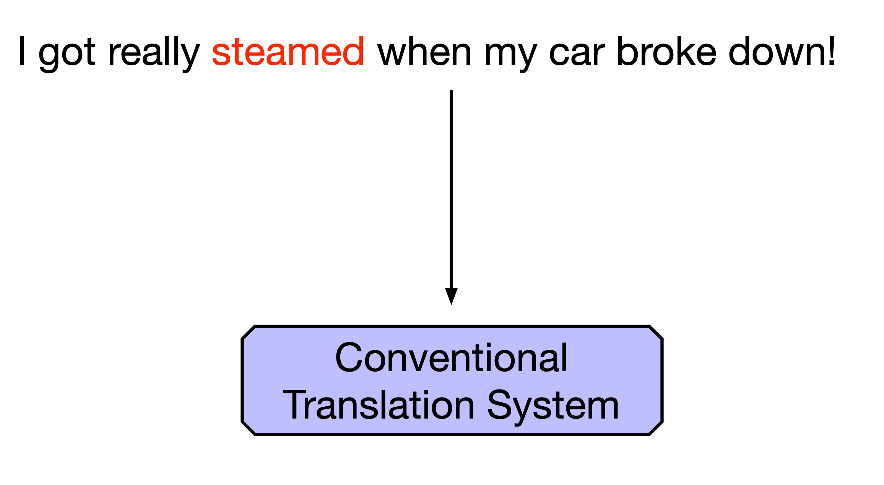
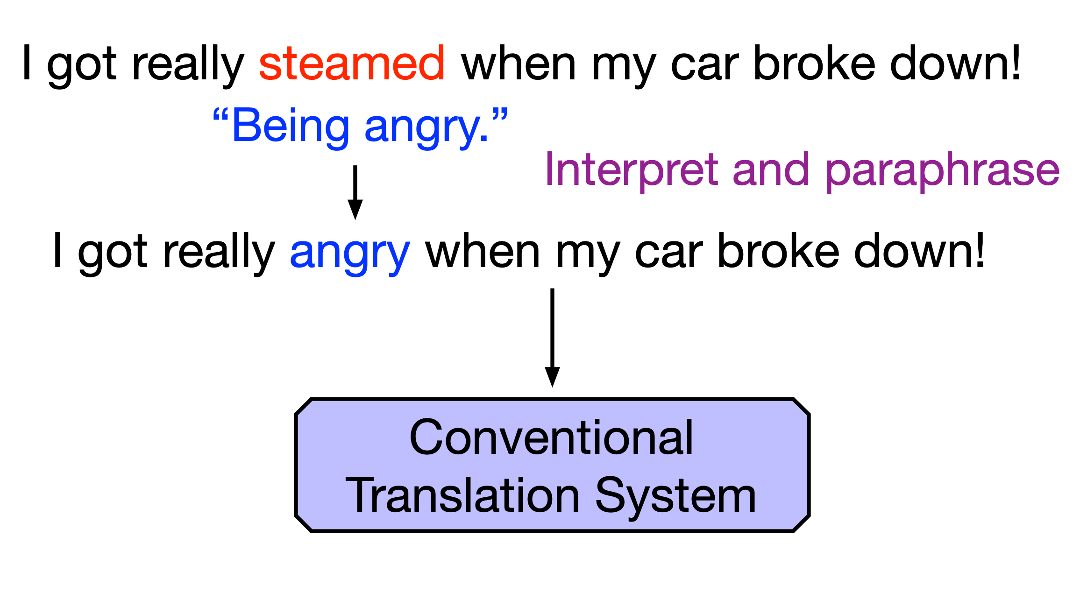
Slang translation
Translate sentences containing slang by first replacing the slang with an interpreted paraphrase:

Slide 15
Results – Slang translation
Given a sentence containing a slang, apply the LM-based interpreter (with or without semantically informed slang interpretation (SSI)) before translating.
Language Pairs | BLEU | BLEU |  | BLEURT | BLEURT |  | COMET | COMET
 | Baseline | LM only | LM + SSI | Baseline | LM only | LM + SSI | Baseline | LM only | LM + SSI
EN → FR | 54.07 | 63.08 | 64.15 | 41.92 | 56.76 | 57.56 | -0.28 | 0.13 | 0.18
EN → DE | 56.43 | 63.27 | 64.02 | 49.61 | 63.74 | 63.75 | -0.29 | 0.14 | 0.20

Slide 16
Conclusion
Knowledge about slang semantic extension can be incorporated to improve automated slang interpretation.
Computational framework combining both semantic and contextual knowledge that effectively interpret and translate slang usage.

Slide 17


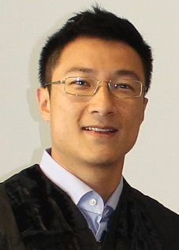
Thank you!
Code and data: https://github.com/zhewei-sun/slanginterp
Link to paper: https://arxiv.org/abs/2205.00616
Zhewei Sun
University of Toronto
Richard Zemel
University of Toronto
Vector Institute of AI
Yang Xu
University of Toronto
Vector Institute of AI

Slide 18
Appendix – Slang translation plots
Given a sentence containing a slang, apply the LM-based interpreter (with or without semantically informed slang interpretation (SSI)) before translating.
EN
→
FR
EN
→
DE
Notes:
Aggregate results
One example

Slide 19
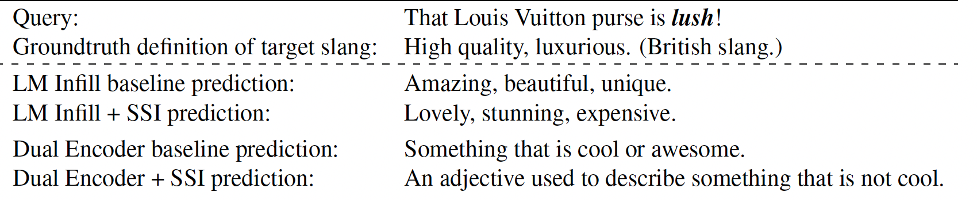
Appendix – Interpretation examples
Notes:
Example data entry

Slide 20
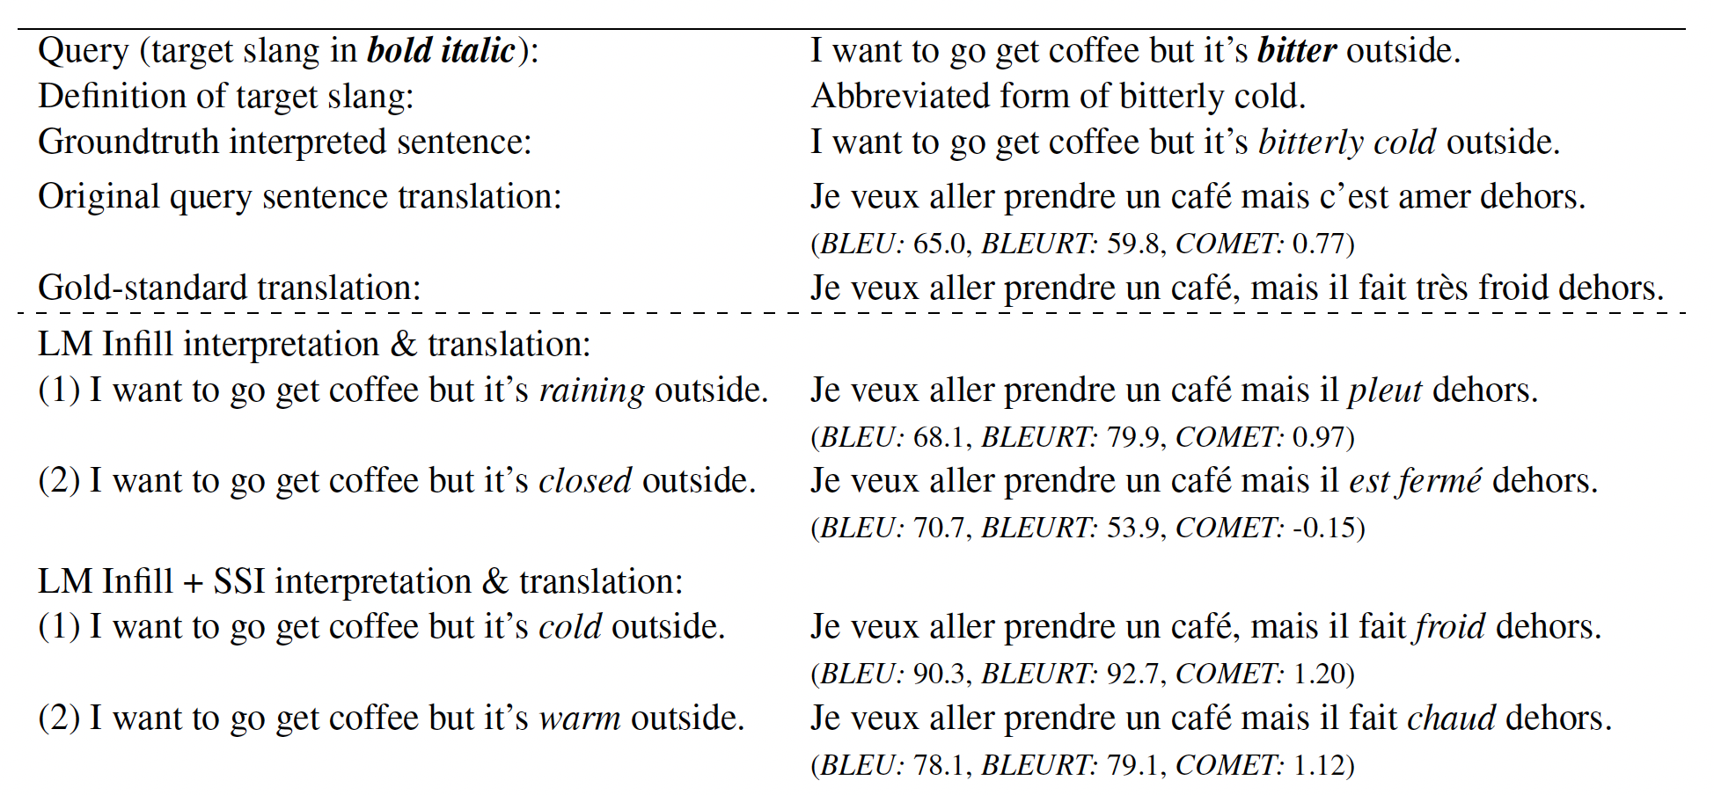
Appendix – Translation examples
Notes:
Example data entry

